Slide 1

Prediction of High Energy Exotic Particle Reaction using Machine Learning
Amol Gupte
May 23rd 2020

Slide 2
Project Objective
Comparison of Machine Learning classification algorithms to find out which gives more accuracy in predicting the presence of exotic particles
Classification algorithms used
Neural Network
Decision Tree
Random Forest

Slide 3
Dataset
High energy Physics reactions include collision of sub-atomic particles which could generate exotic particles
However these exotic particles disintegrate at a very high speed, making it difficult for the sensors to detect their presence
At the same time these reactions might not generate exotic particles at all, thereby directly generating disintegrate particles
It was difficult for scientists to find out if exotic particles have been generated or not. In this project I have used Machine Learning techniques to detect the generation of exotic particles
Dataset considered for this analysis consist of signal generated from both types of reactions mentioned above and their corresponding output
To be precise, there are 28 features of the signal and one target (either 1 or 0) indicating presence or absence of exotic particles

Slide 4
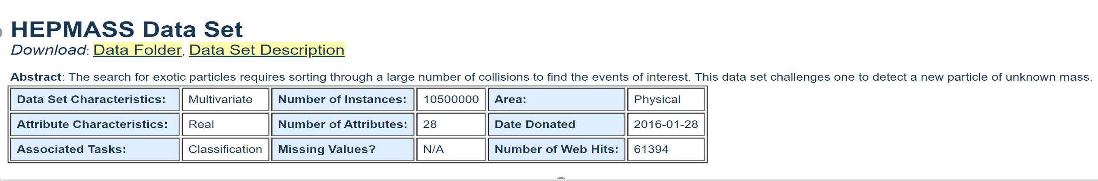
Data Preprocessing
As we can see the number of instances are huge, thus for ease of computation 500,000 instances were used for the study of classification methodologies.
So, out of 500,000 instances, 400,000 were used for training and 100,000 were used for testing the models (80/20 split) using Python Pandas.
Further, the data was standardized using the preprocessing module of sklearn.
Dataset source –
https://archive.ics.uci.edu/ml/datasets/HEPMASS

Slide 5
Tools used
Python Pandas
Matplotlib
Tensor flow
sklearn
Methodology used
Neural Network
Decision Tree
Random Forest

Slide 6
Neural Network(1/3)
Architecture
Input layer of 28 attributes of exotic particles
Hidden layers
First layer of 512 neuron
Second layer of 384 neurons
Third layer of 256 neurons
Output layer
One neuron confirming presence of absence of exotic particle
Training
Epochs = 50
Batch size = 400
Validation split = 10%

Slide 7
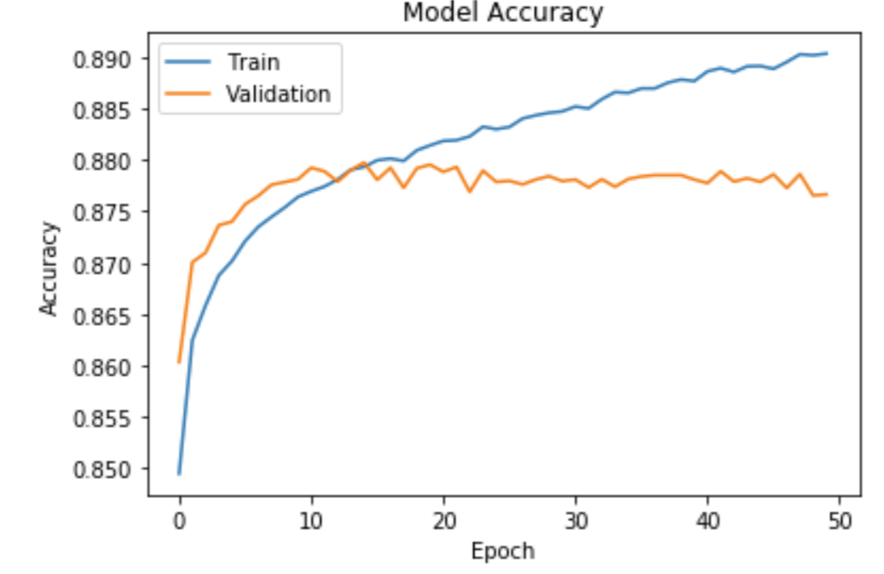
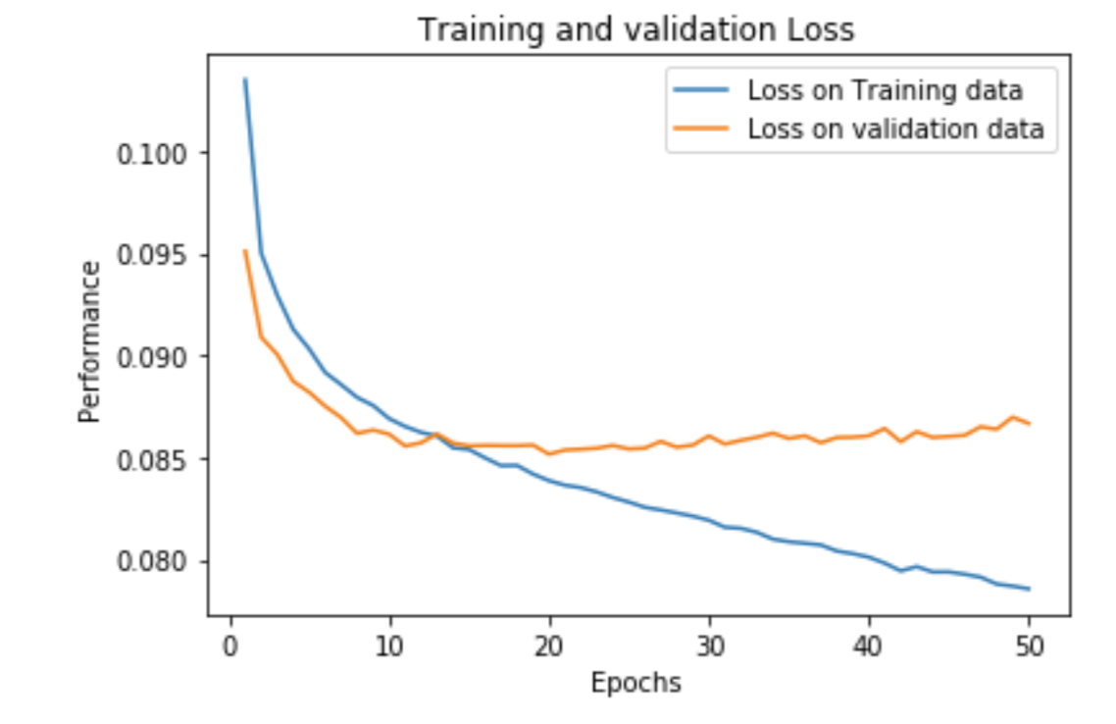
Neural Network(2/3)
Results
Accuracy
Training Data: 89.08%
Validation Data: 87.79%
Testing Data: 87.78%

Slide 8
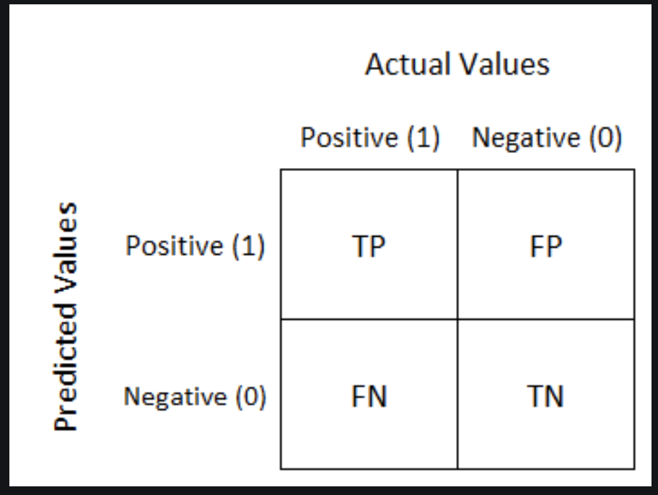
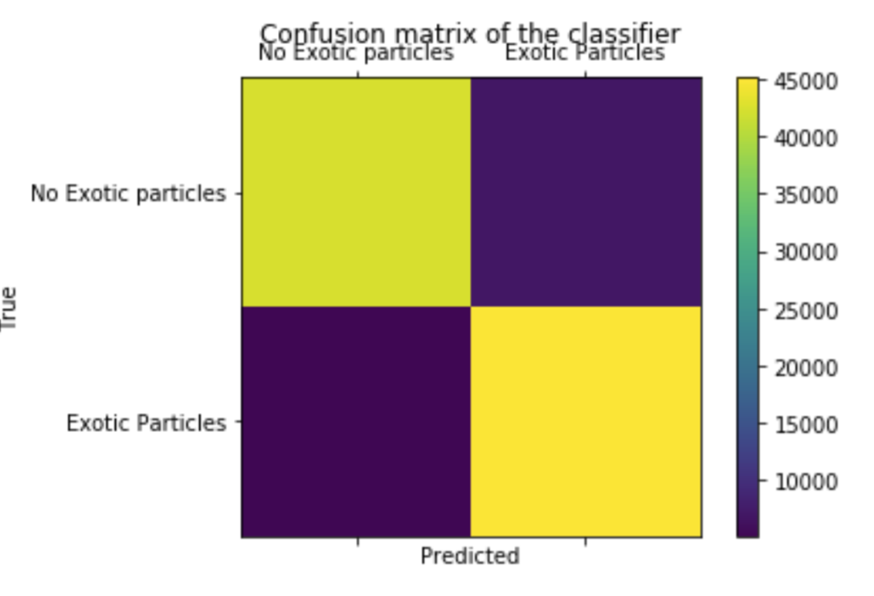




Neural Network(3/3)
Results: Confusion Matrix
Precision: 85.02%(TP/TP+FP)
Recall: 89.86%(TP/TP+FN)

Slide 9
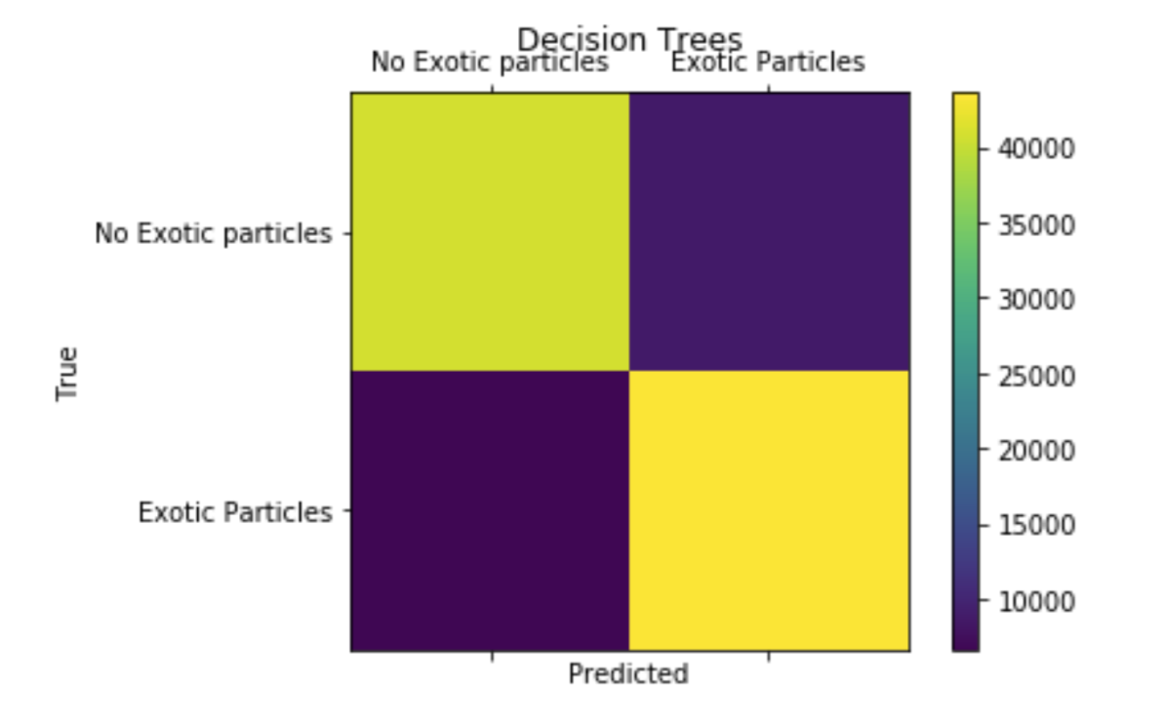




Decision Tree
Architecture
Max Leaf nodes = 7000
Max depth = 15
Results: Confusion Matrix
Accuracy
Training Data: 90.74%
Testing Data: 84.57%
Precision: 82.26%(TP/TP+FP)
Recall: 86.09%(TP/TP+FN)

Slide 10
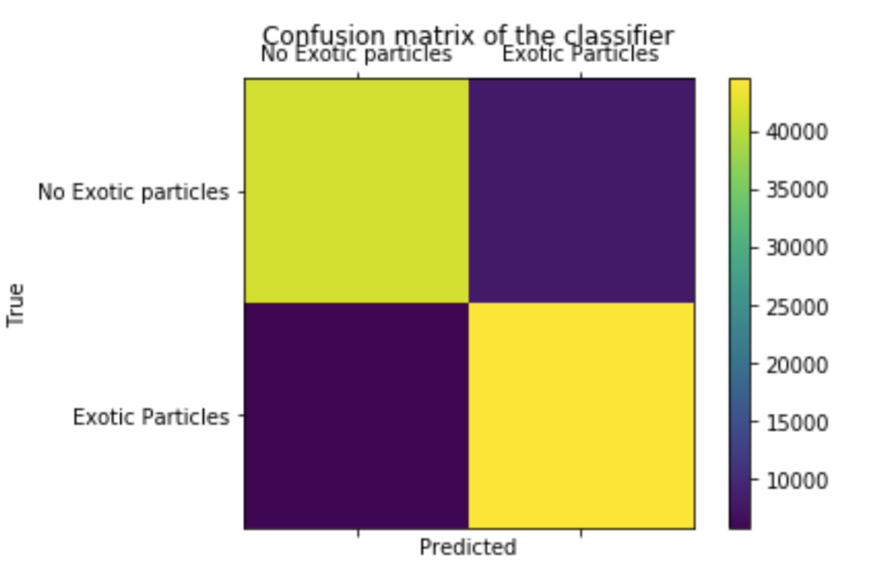




Random Forest
Architecture
Max Leaf nodes = 10,000
Max depth = 15
Number of Trees = 150
Results: Confusion Matrix
Accuracy
Training Data: 91.26%
Testing Data: 86.14%
Precision: 83.59%(TP/TP+FP)
Recall: 87.94%(TP/TP+FN)

Slide 11
Conclusion
Performance of Neural Network was better than Random Forest and Decision Tree
Random Forest vs Decision Tree
Training accuracy for Random Forest increased by 0.65% as compared to Decision tree; whereas the testing accuracy increased by 1.6%. We can conclude that Random Forest showed better generalization ability as compared to Decision Tree

Slide 12
Thank you to Svitlana, TAs and this team!

